Slide 1
Multi Threading
Concurrent execution of different tasks of same program at the same time we called it as multi threading.
Which improves the CPU utilization.
Context Switching takes less time.
The users are not blocked because threads are independent, and we can perform multiple operations at times

Slide 2
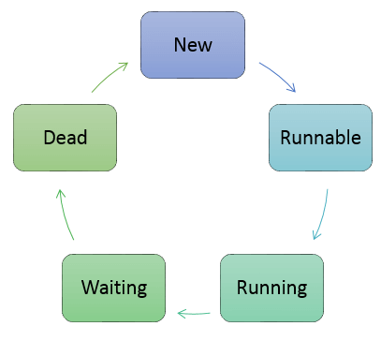
Thread Life Cycle

Slide 3
Definitions
New: In this phase, the thread is created using class “Thread class". It remains in this state till the program starts the thread.
Runnable: In this page, the instance of the thread is invoked with a start method. The thread control is given to scheduler to finish the execution. It depends on the scheduler, whether to run the thread.
Running: When the thread starts executing, then the state is changed to “running” state. The scheduler selects one thread from the thread pool, and it starts executing in the application.
Waiting: This is the state when a thread has to wait. As there multiple threads are running in the application, there is a need for synchronization between threads. Hence, one thread has to wait, till the other thread gets executed. Therefore, this state is referred as waiting state.
Dead or Terminate : This is the state when the thread is terminated. The thread is in running state and as soon as it completed processing it is in “dead state” or “Terminated”.

Slide 4
commonly used methods for threads
start() | This method starts the execution of the thread and JVM calls the run() method on the thread.
Sleep(int milliseconds) | This method makes the thread sleep hence the thread’s execution will pause for milliseconds we provided and after that, again the thread starts executing. This help in synchronization of the threads.
getName() | It returns the name of the thread.
join () | Which allows one thread class to wait until another thread completes its execution.

